Slide 1
Multiple-Table Queries

Slide 2
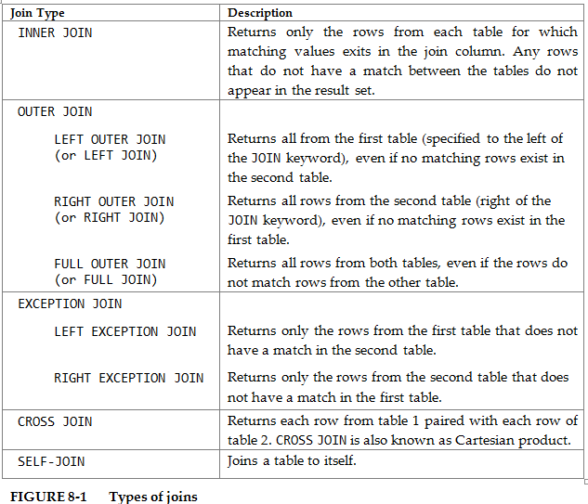

Slide 3
Inner Join
An inner join creates a result set by combining column values of two tables based upon a join condition
Methods used to specify an inner join:
INNER JOIN/ON clauses
WHERE clause
Do not use
What is the purpose of the WHERE clause?
USING clause – next semester in Oracle

Slide 4
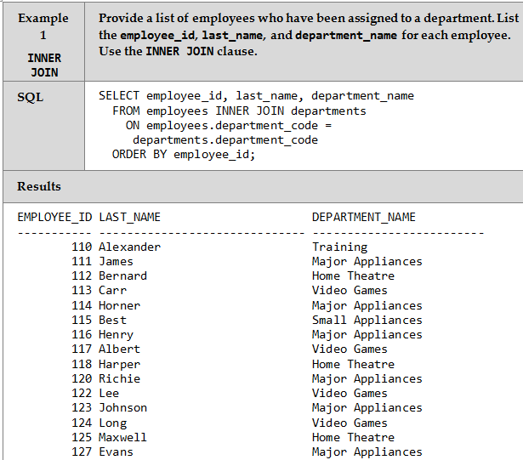
INNER JOIN /ON Clause

Slide 5
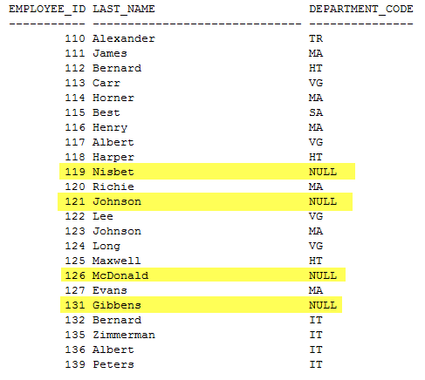
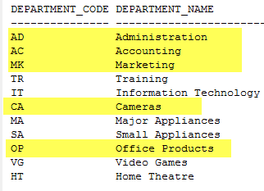
INNER JOIN/ON Example 1

Slide 6
Alias Names
Two types of aliases:
Column name alias
Table name alias

Slide 7
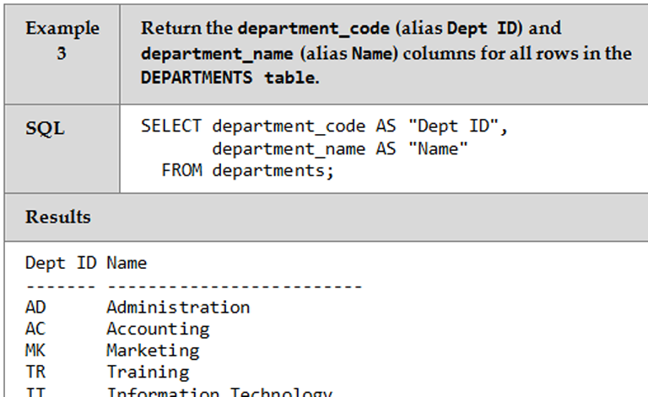
Column Name Alias

Slide 8
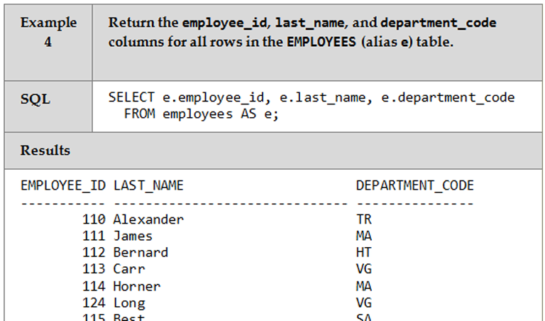
Table Name Alias

Slide 9
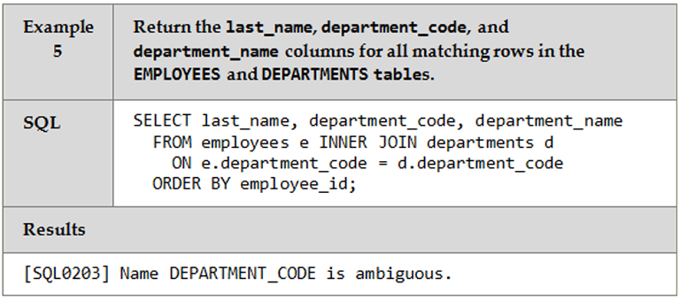
Table Alias Name are Sometimes Required

Slide 10
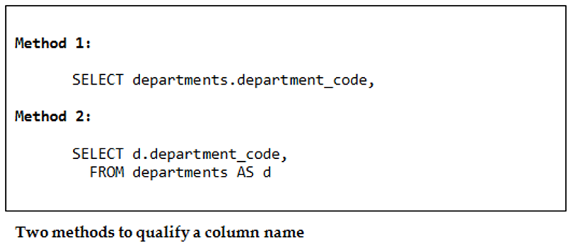
Solve Ambiguous Errors

Slide 11
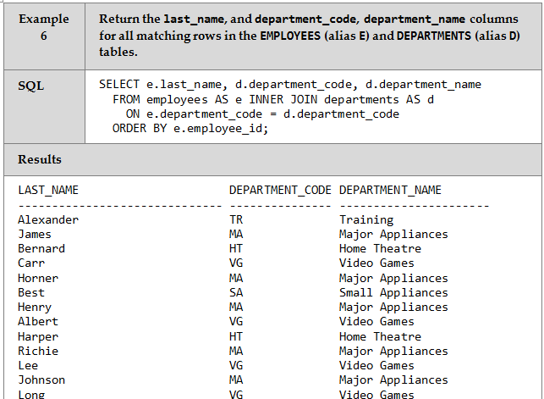
Solution

Slide 12
Outer Join
The OUTER JOIN includes the rows produced by the inner join as well as the missing rows, depending on the type of outer join:
A LEFT OUTER JOIN or LEFT JOIN includes the rows from the left table that were missing from the inner join
A RIGHT OUTER JOIN or RIGHT JOIN includes the rows from the right table that were missing from the inner join
A FULL OUTER JOIN or FULL JOIN includes the rows from both tables that were missing from the inner join

Slide 13
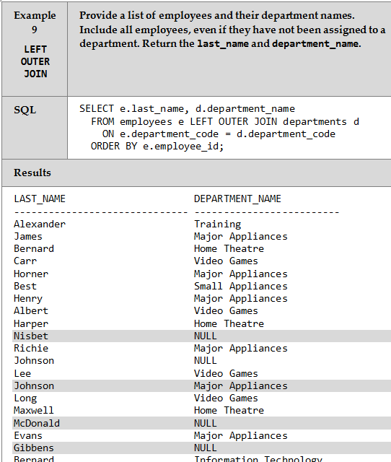
LEFT Outer Join

Slide 14
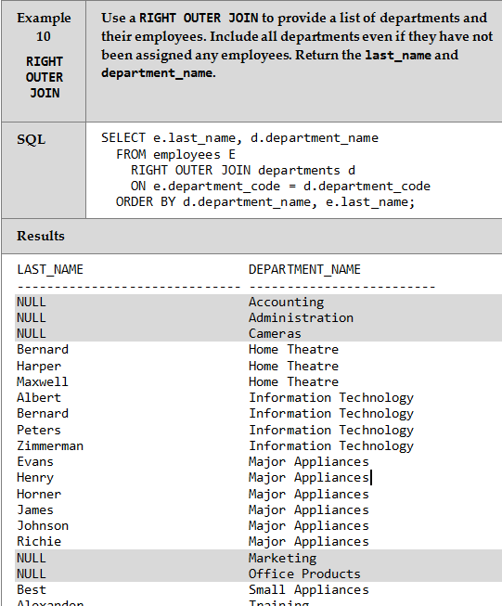
RIGHT Outer Join

Slide 15
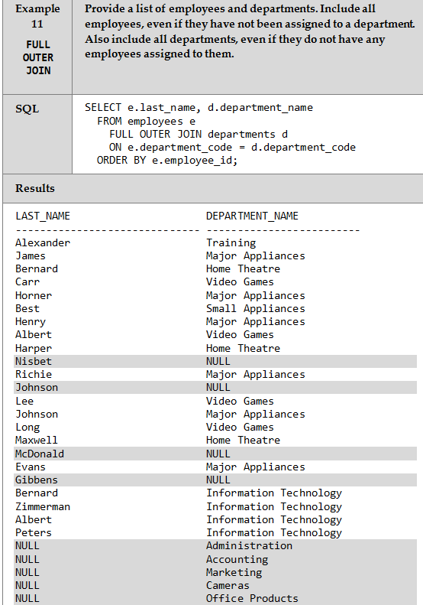
FULL Outer Join

Slide 16
Exception Join
Exception joins include only the missing rows from an inner join, depending on the type of exception join:
A LEFT EXCEPTION JOIN includes only the rows from the left table that were missing from the inner join
A RIGHT EXCEPTION JOIN includes only the rows from the right table that were missing from the inner join

Slide 17
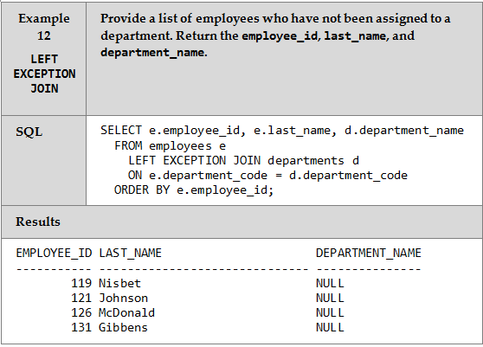
LEFT Exception Join

Slide 18
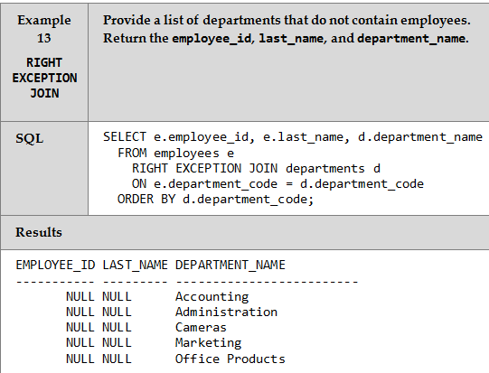
RIGHT Exception Join

Slide 19
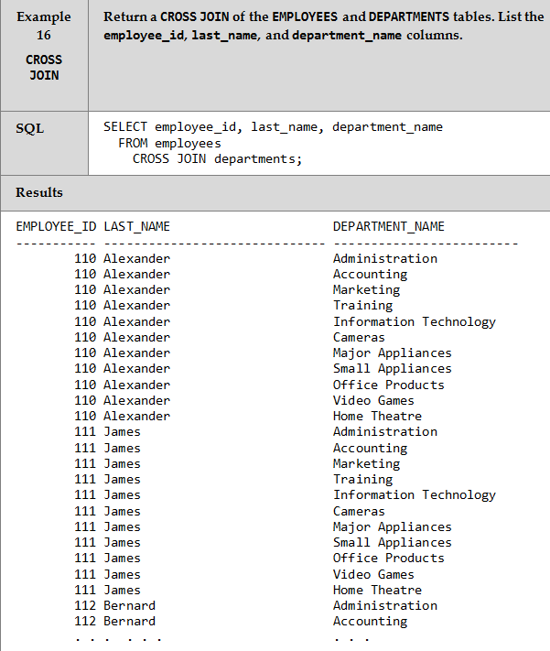
CROSS Join

Slide 20
Self-Join
A self-join is a join in which a table is joined to itself
A table assumes several roles in the From clause
A table alias is used to identify which table role is meant when specifying a column name in any of the other clauses

Slide 21
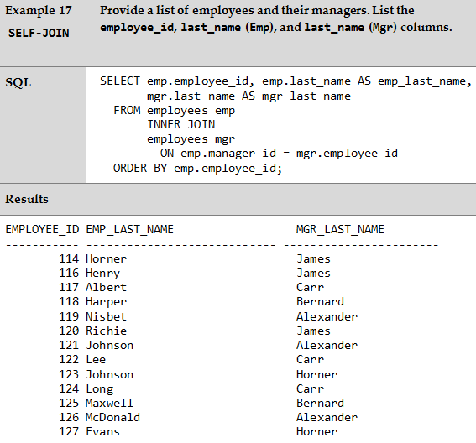
SELF-JOIN

Slide 22
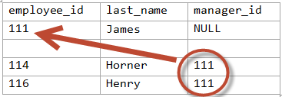
SELF-JOIN

Slide 23
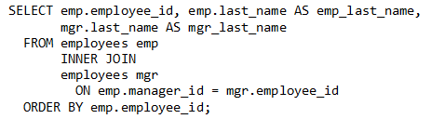
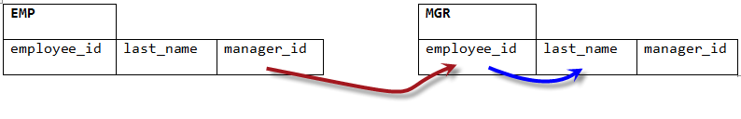
SELF-JOIN

Slide 24
Self-Join – Manager Example
Provide a list of managers and the employees that report to each manager
List the manager number, manager last name, and the last name of each employee reporting to that manager

Slide 25
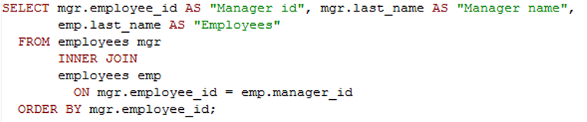
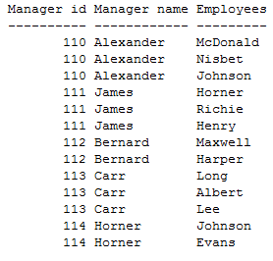
SELF-JOIN – Manager example

Slide 26
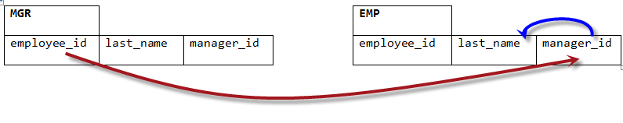
SELF-JOIN – Manager example

Slide 27
UNION Operator
The UNION operator is used to select related information from two tables
JOIN combines columns from two or more tables
UNION combines rows from two or more result sets
The Select statement of both tables must have the same number of columns, and the corresponding columns need to be of the same data type

Slide 28
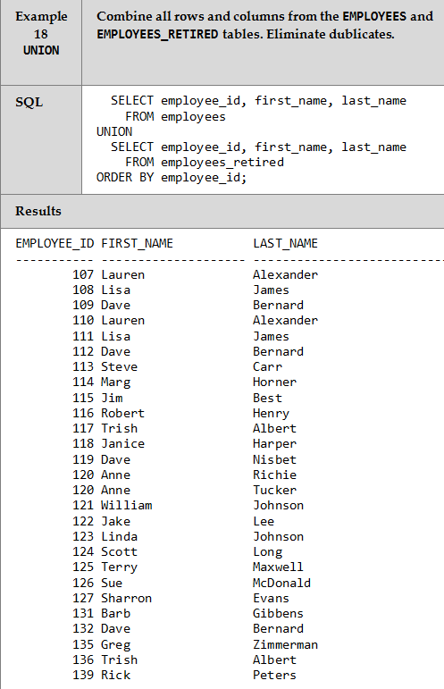
UNION Operator

Slide 29
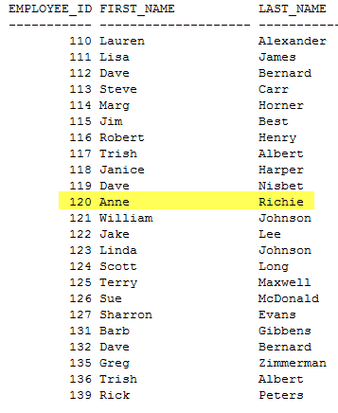
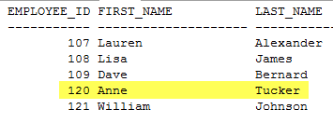
UNION Operator

Slide 30
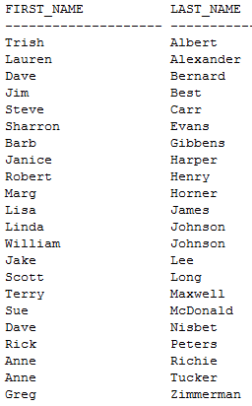
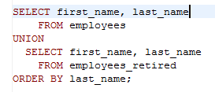
UNION Operator Only distinct value are returned

Slide 31
UNION ALL Operator
Equal to the UNION operator, except that UNION ALL selects all rows

Slide 32
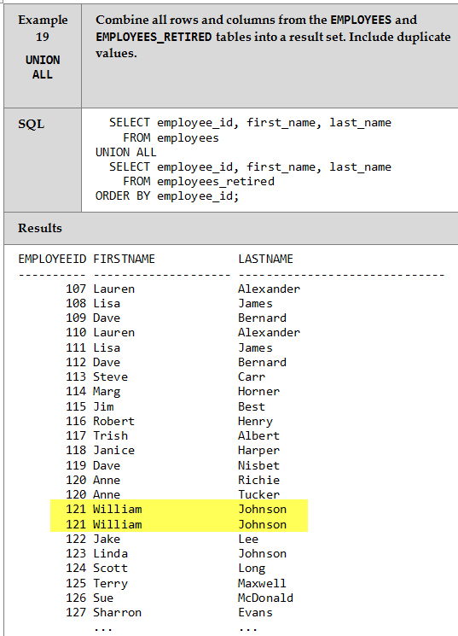
UNION ALL Operator

Slide 33
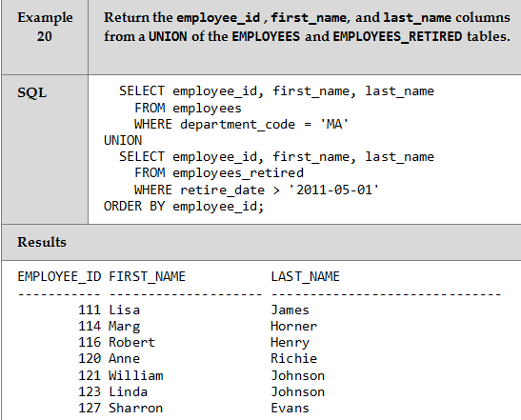
Using WHERE with UNION

Slide 34
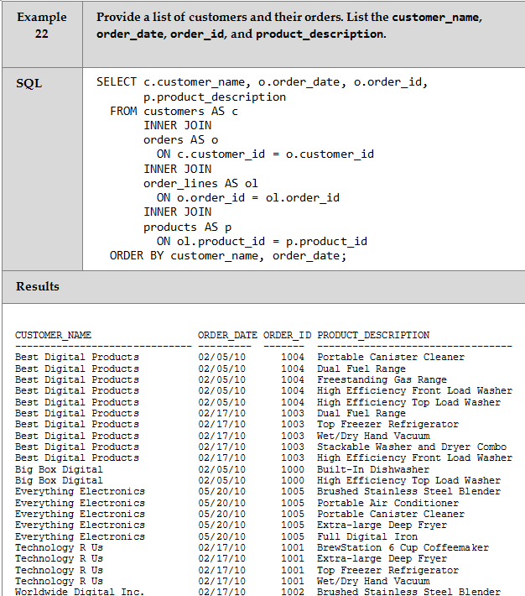
Joining Several Tables

Slide 35
The End ☺

